Slide 1
Install Git in PHPStorm

Slide 2
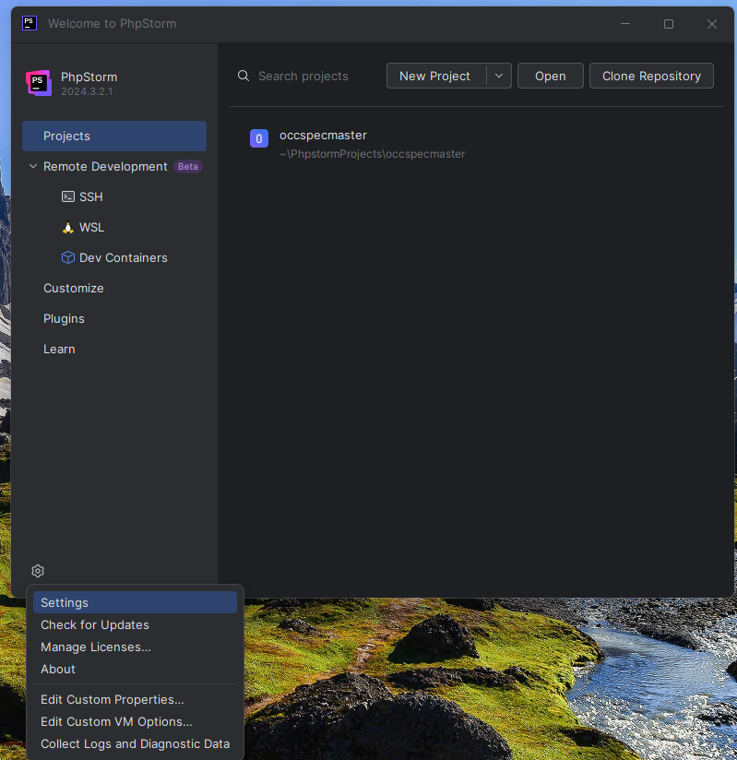
Access settings
Either from this menu
Or any other route

Slide 3
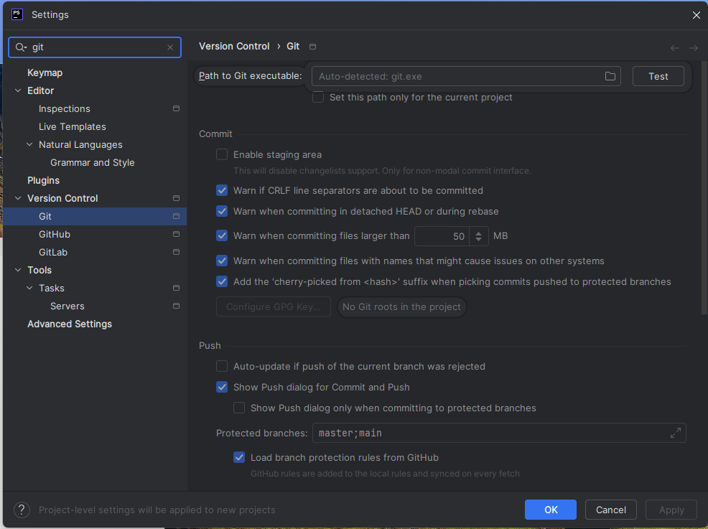
Search for git
Search in here
Look for this
”test” button

Slide 4
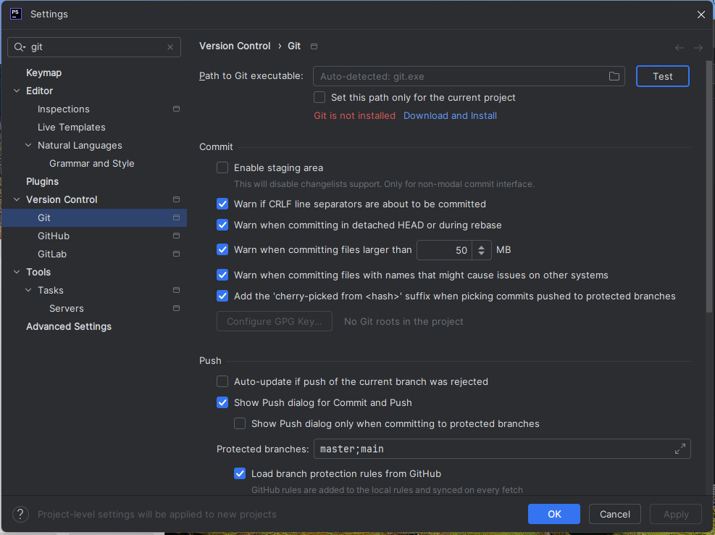
Press Test then..
Press Test
Then click
”Download and
install”

Slide 5
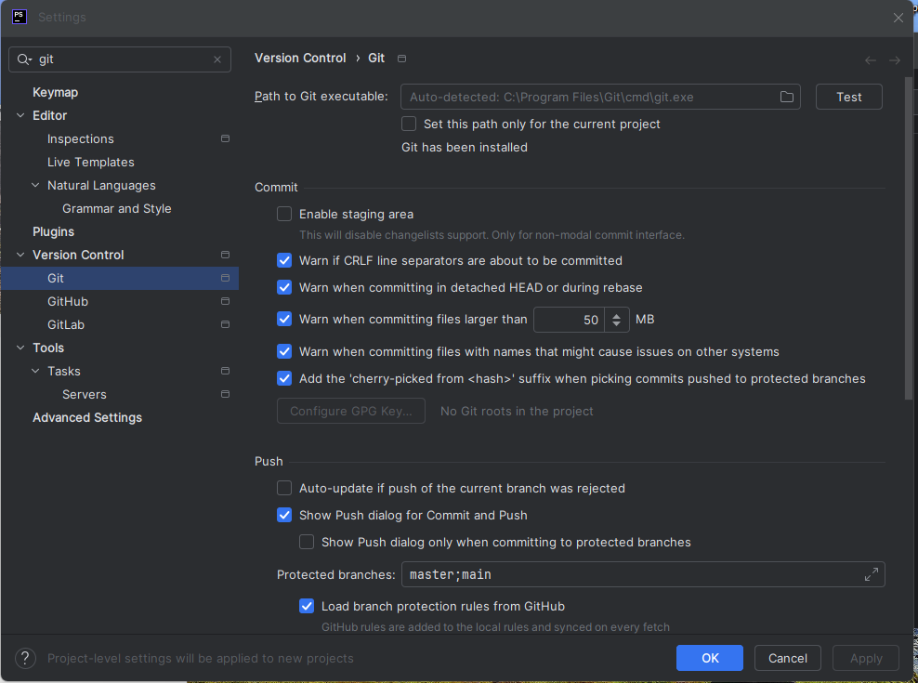
Go through the motions
Follow any
prompts
Then its installed

